Slide 1
Security Keypad

Slide 2
Features
Real Hardware Anti-keylogger
Pro-active Anti-keylogger
FIPS Certification in CAVP (Cryptographic Algorithm Validation Program).
Protect Your ID and Password
Small and Slim
Wire USB and Wireless Type
For Notebook and Desktop Users
for Windows XP/Vista/7

Slide 3
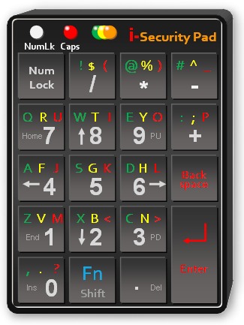
Keypad Security
User name: qod73jfny
Password: di7lnd
Garbled Output
User name: JamesChen
Password: 123456
Enter Codes

Slide 4
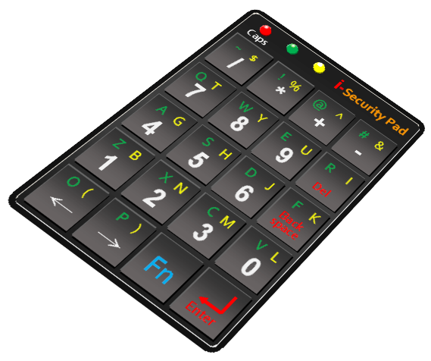
Wire/Wireless Solutions
Wire USB Wireless(2.4G)

Slide 5
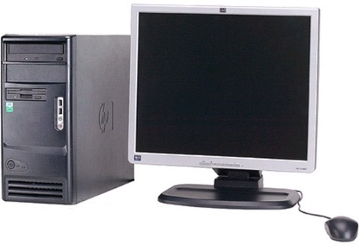
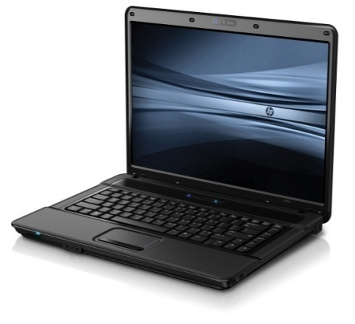
Applications
Desk-top PC
Notebook

Slide 6
S/W Anti-keylogger
Pure Software Anti-keylogger
Advanced Anti Keylogger Classic (Spydex Inc.)
US$ 59.95
Advanced Anti Keylogger Lite (Spydex Inc.)
US$ 39.95
Advanced Anti Keylogger (Global Information Technology, UK)
US$37.75
SpyShelter Premium (SpyShelter Inc.)
EUR $24.95
US$34.0

Slide 7
Security Keypad Usage-1
Press “Num-lock” key to select the number or control keys.
Security
Keypad
Security
Keypad
NumLk Caps
NumLk Caps
! $ ( @ % ) # ^ _
Q R U W T I E Y O : ; P
A F J S G K D H L
Z V M X B < C N >
, . ?
! $ ( @ % ) # ^ _
Q R U W T I E Y O : ; P
A F J S G K D H L
Z V M X B < C N >
, . ?
Num
Lock
-
Num
Lock
-
/
7 8 9 +
4 5 6
1 2 3
0
/
7 8 9 +
4 5 6
1 2 3
0
*
*
Hm
PU
Hm
PU
Back
Back
space
space
End
PD
End
PD
Fn
Shift
.
Enter
Fn
Shift
.
Enter
Ins
Del
Ins
Del
The number keys are available.
( 0, 1, 2, 3, 4, 5, 6, 7, 8, 9, +, -, *, /, ., Num-lock, Back-space, Enter )
The control keys are available.
( +, -, &, /, Home, End, PU, PD, ↑, ↓,→,← , Num-lock, Back-space, Del, Enter )

Slide 8
Security Keypad Usage-2
Press “Fn” key to select the character group.
Security
Keypad
Security
Keypad
Security
Keypad
NumLk Caps
NumLk Caps
! $ ( @ % ) # ^ _
Q R U W T I E Y O : ; P
A F J S G K D H L
Z V M X B < C N >
, . ?
! $ ( @ % ) # ^ _
Q R U W T I E Y O : ; P
A F J S G K D H L
Z V M X B < C N >
, . ?
! $ ( @ % ) # ^ _
Q R U W T I E Y O : ; P
A F J S G K D H L
Z V M X B < C N >
, . ?
Num
Lock
Num
Lock
Num
Lock
/
7 8 9 +
4 5 6
1 2 3
0
-
/
7 8 9 +
4 5 6
1 2 3
0
/
7 8 9 +
4 5 6
1 2 3
0
-
*
-
*
*
Hm
PU
Hm
PU
Hm
PU
Back
Back
Back
space
space
space
End
PD
End
PD
End
PD
Fn
Shift
.
Enter
Fn
Shift
.
Enter
Fn
Shift
.
Enter
Ins
Del
Ins
Del
Ins
Del
The Green Character keys are available.
( !, @, #, Q, W, E, :, A, S, D, Z, X, C, “,”, Num-lock, Back-space, Del, Enter )
The Yellow Character keys are available.
( $, %, ^, R, T, Y, ;, F, G, H, V, B, N, Num-lock, Back-space, Del, Enter )
The Red Character keys are available.
( “(“, “)”, _, U, I, O, P, J, K, L, M, <, > ?, Num-lock, Back-space, Del, Enter)

